Slide 1
The 5 E’s of Collaboration
Renee Funes, George Garcia, Patty Hanafee,
Lori McCaughtry, Corrie Sharp
Notes:
Image from: https://www.mnnonline.org/news/collaboration-north-american-missions/

Slide 2
Notes:
http://www.slideshare.net/jatinderksaini5/literacy-is-not-enough?qid=ea86a3e1-17d0-4a57-aa98-71287e8bdc51&v=qf1&b=&from_search=1

Slide 3
The group
Roles and responsibilities
Norms
Defining the scope of the project
Information Needs
Leadership
Group Contract
Notes:
Image from:http://www.griaf.unipa.it/establish/index.htm

Slide 4
The Group
Teamwork
Global Citizenship/Digital Citizenship
Self Awareness

Slide 5
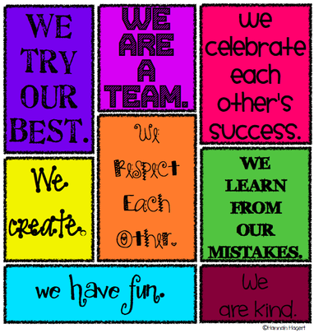
Norms
All team members work toward a common goal
All participants are valued
Strong sense of purpose
Trust and sense of a shared responsibility
Notes:
Image from:http://www.cmmusick5.com/classroom-norms-and-expectations.html

Slide 6
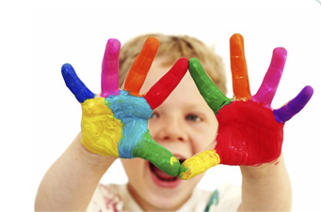
Defining the problem
Defining the current situation
Defining the desired future
Specifying the information needs
Identifying the information that is available and what is needed
Educating the rest of the collective
Developing a written plan of action: what, how, when where and who

Slide 7
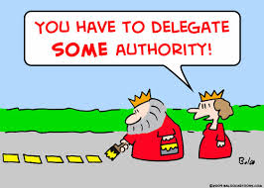
Overview
Plan for event
Collectively Delegate Responsibilities
Step by Step Plan
Troubleshoot Problems
Notes:
Image from: http://www.dreamstime.com/stock-images-word-engineer-magnified-image10701734

Slide 8
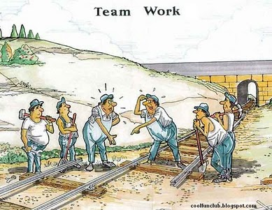
Pressure-Test the Theoretical Solution
Put the Plan into Action
DO WHAT YOU SAY YOU’RE GOING TO DO!

Slide 9
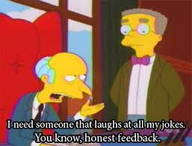
Was the Challenge Met and Goal Achieved?
Discuss areas of improvement
Acknowledge Contributions
Provide Constructive Feedback
Notes:
Image from: https://www.colourbox.com/image/examine-word-shows-examination-examining-and-checking-image-7849824?ver=b&utm_expid=22365066-58.v-3AC9HPS7Cpc4GJpp1ntA.1&utm_referrer=https%3A%2F%2Fwww.google.com%2F

Slide 10
Lee Crockett on Collaboration...
Notes:
https://globaldigitalcitizen.org/collaboration-fluency-video

Slide 12
